Slide 1
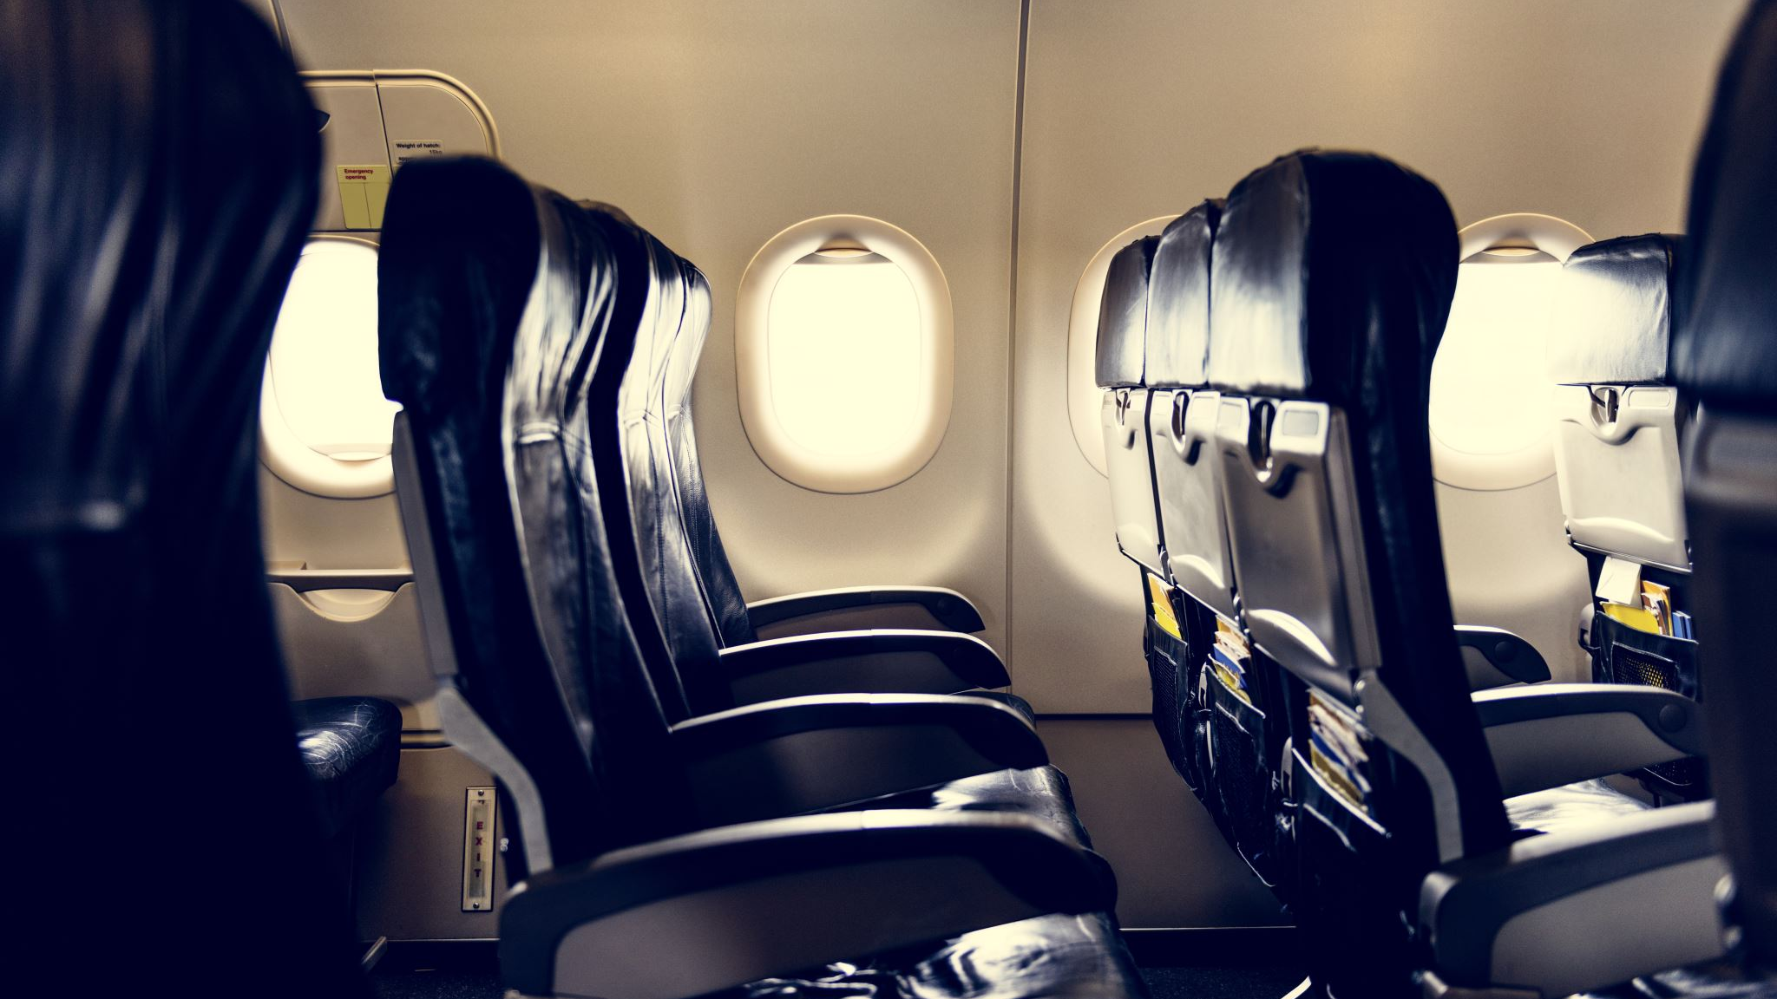
BRITISH AIRWAYS
Web Scraping and Data Analysis
Bhavana Palapati

Slide 2
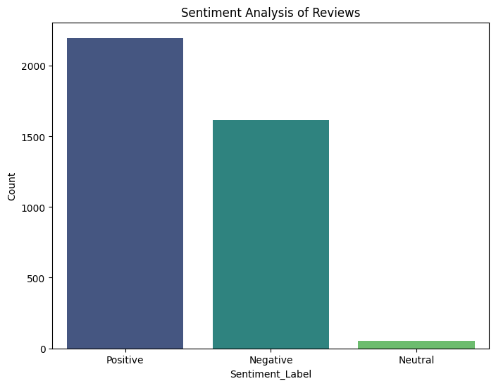
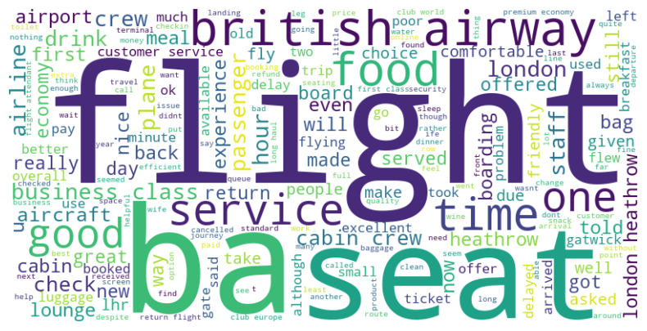
Insights of Customer Reviews from Skytrax
Total Analyzed Reviews: 3864 (100%)
Positive Reviews: 2198 (56%)
Negative Reviews: 1615 (41%)
Neutral: 51 (2%)
Word Cloud generated from most frequently mentioned words in the customer reviews.

